Slide 1

Question-driven content design (QDCD)
Question-driven content design (QDCD)
Sarah Packowski
AI ContentOps Architect, IBM

Slide 2
Agenda
How content fuels RAG and AI agents
Traditional content design process
How the traditional process fails RAG, AI agents
Solution: question-driven content design
Hands-on demonstration

Slide 3
1/5 How content fuels RAG and AI agents
RAG and agentic solutions cannot work without pulling in accurate, up-to-date, domain-specific content that writers create.

Slide 4
1/5 How content fuels RAG and AI agents
RAG and agentic solutions cannot work without pulling in accurate, up-to-date, domain-specific content that writers create.
Thing 1 to remember

Slide 5



Retrieval-augmented generation (RAG)
User input (question)
LLM generates output
Knowledge base (articles)
Article:
<article-text>
Answer the question based on the article.
Q: <question-text>
A:
Search for relevant articles
Grounded prompt

Slide 6
Retrieval-augmented generation (RAG)
User input (question)
LLM generates output
Knowledge base (articles)
Article:
<article-text>
Answer the question based on the article.
Q: <question-text>
A:
Search for relevant articles
Grounded prompt

Slide 7

Scenario
You have invented a new hand-held writing implement, called the carbonWrite 9000
Image generated using ChatGPT

Slide 8
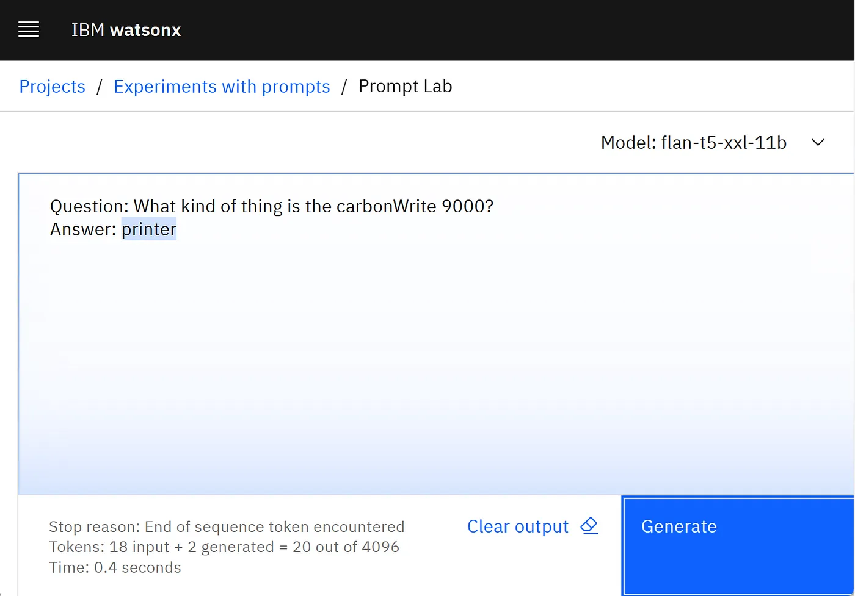
watsonx.ai

Slide 9
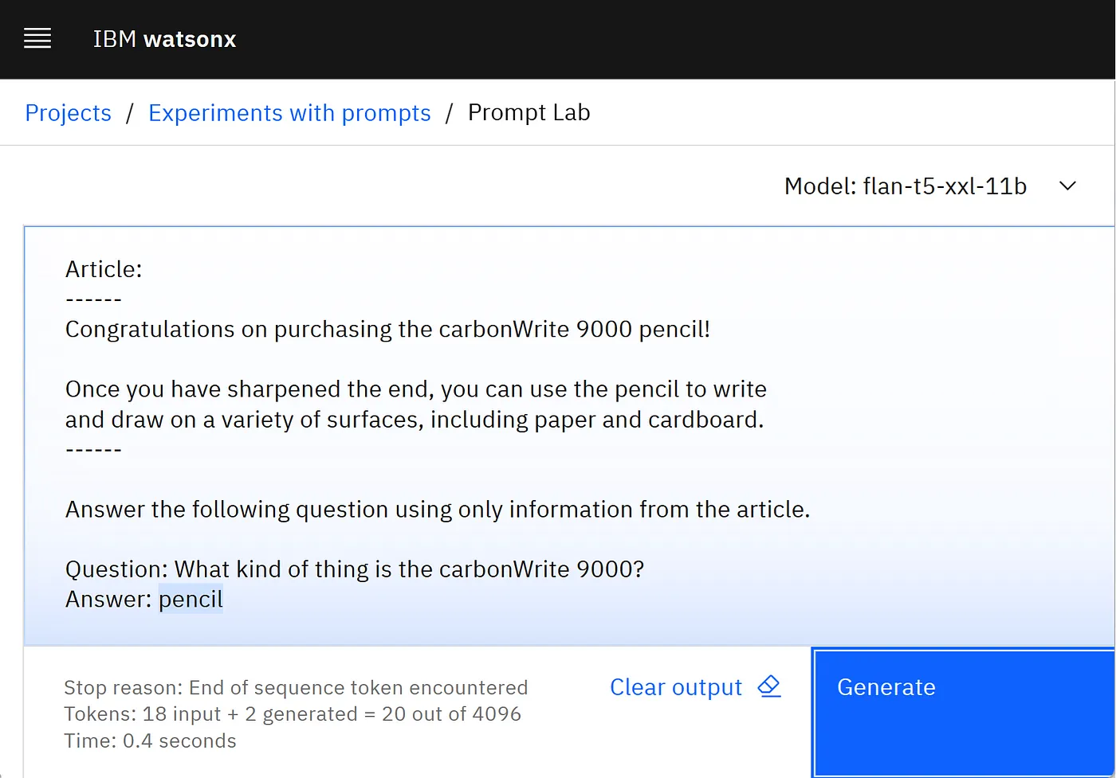
watsonx.ai

Slide 10
AI agents
What is the command to achieve the goal in the following user input?
API reference:
--------------------------- To configure the carbonWrite 9000 battery mode, call battery_config.
## Syntax
battery_config [ performance | longevity ]
### Example 1: For performance
battery_config performance
### Example 2: For long battery life
battery_config longevity
---------------------------
User input: I wish the battery lasted longer
A: battery_config longevity
I wish the battery lasted longer
Knowledge base (articles, database)
User input
(action request)
Search for relevant info

Slide 11
AI agents
What is the command to achieve the goal in the following user input?
API reference:
--------------------------- To configure the carbonWrite 9000 battery mode, call battery_config.
## Syntax
battery_config [ performance | longevity ]
### Example 1: For performance
battery_config performance
### Example 2: For long battery life
battery_config longevity
---------------------------
User input: I wish the battery lasted longer
A: battery_config longevity
I wish the battery lasted longer
Knowledge base (articles, database)
User input
(action request)
Search for relevant info

Slide 12
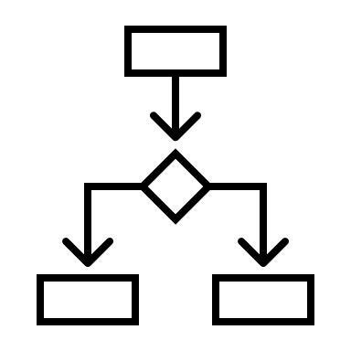
AI agents
API reference:
---------------------------
<article-text>
---------------------------
User input: I wish the battery lasted longer
Is there a command to accomplish this goal?
A: yes
Is it a system command or REST API?
A: system command
What is the command, with parameters?
A: battery_config longevity
I wish the battery lasted longer
Knowledge base (articles, database)
Search for relevant info
User input
(action request)
Application logic

Slide 13
AI agents
API reference:
---------------------------
<article-text>
---------------------------
User input: I wish the battery lasted longer
Is there a command to accomplish this goal?
A: yes
Is it a system command or REST API?
A: system command
What is the command, with parameters?
A: battery_config longevity
I wish the battery lasted longer
Knowledge base (articles, database)
Search for relevant info
User input
(action request)
Application logic

Slide 14
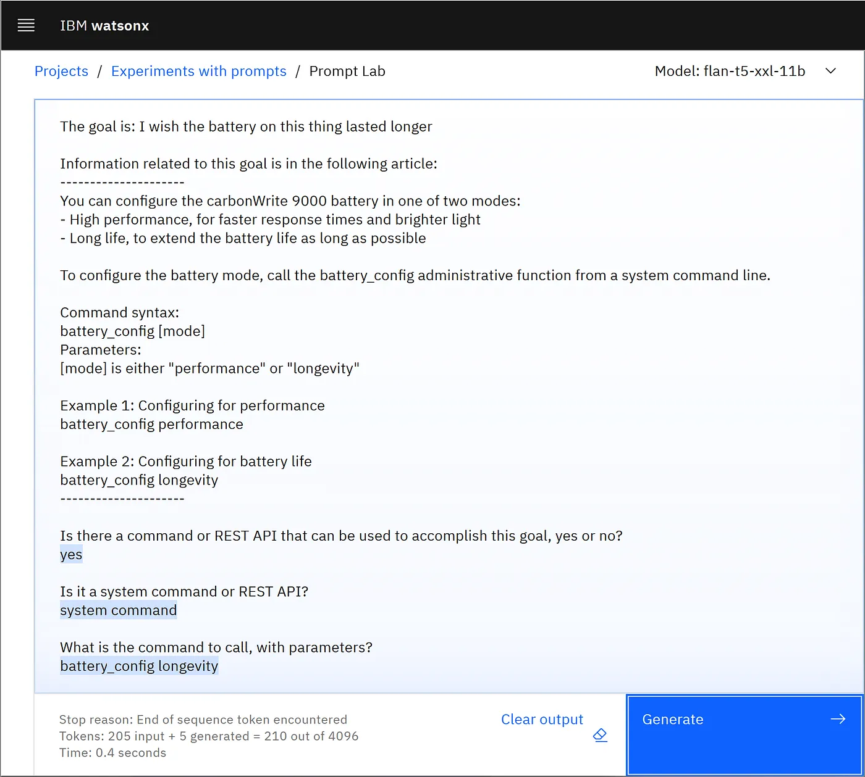
watsonx.ai

Slide 15
1/5 How content fuels RAG and AI agents
RAG and agentic solutions cannot work without pulling in accurate, up-to-date, domain-specific content that writers create.
Thing 1 to remember

Slide 16
2/5 Traditional content design process
Identify concepts users need to understand, tasks users will perform, and reference information users need to perform those tasks
Break the information into pieces, so you can write an individual article for each piece
Map out how all the information pieces will fit together

Slide 17
3/5 How the traditional process fails RAG, AI agents
Real user questions contain “incorrect” terms
Real user questions are based on “misunderstanding”
Real users ask about “unsupported” tasks

Slide 18
Reality: Unexpected questions
Does the pen write on cardboard?
Pencils
Congratulations on purchasing the Carbon9000 pencil!
Once you have sharpened the end, you can use the pencil to write and draw on a variety of surfaces.
If you purchased the optional rubOut eraser feature, you can erase what you’ve written with the pencil.
Can you stir your coffee with it?
Will the ink leak in my pocket?
Can you rewind a cassette tape with it?

Slide 19
3/5 How the traditional process fails RAG, AI agents
Real user questions contain “incorrect” terms
Real user questions are based on “misunderstanding”
Real users ask about “unsupported” tasks
New AI interfaces lack context

Slide 20
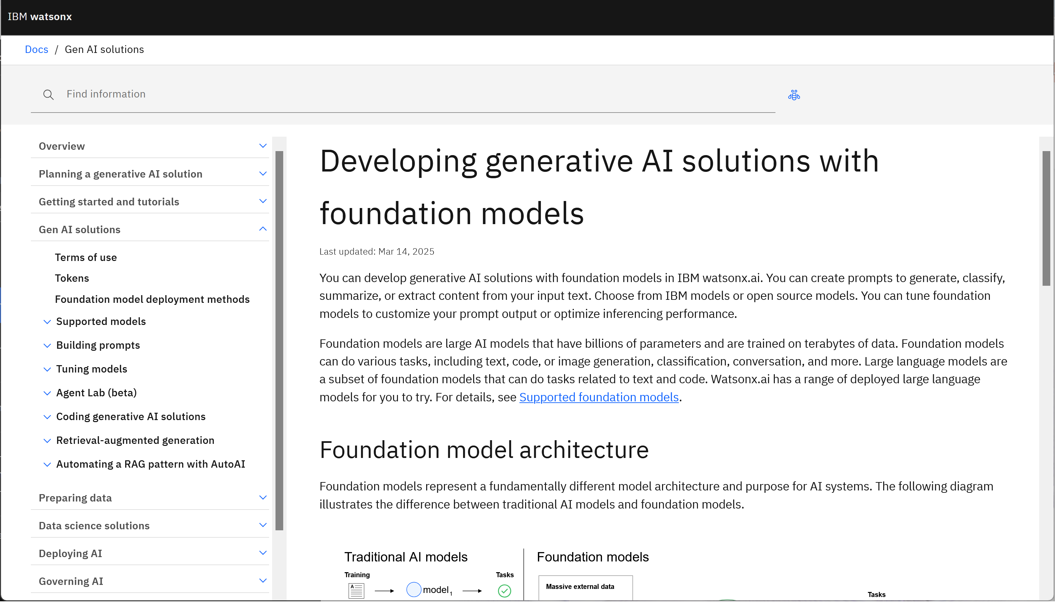
Documentation: provides context
Set expectations, shape user behavior:
Table of content
Headings
Links to details
Diagrams

Slide 21
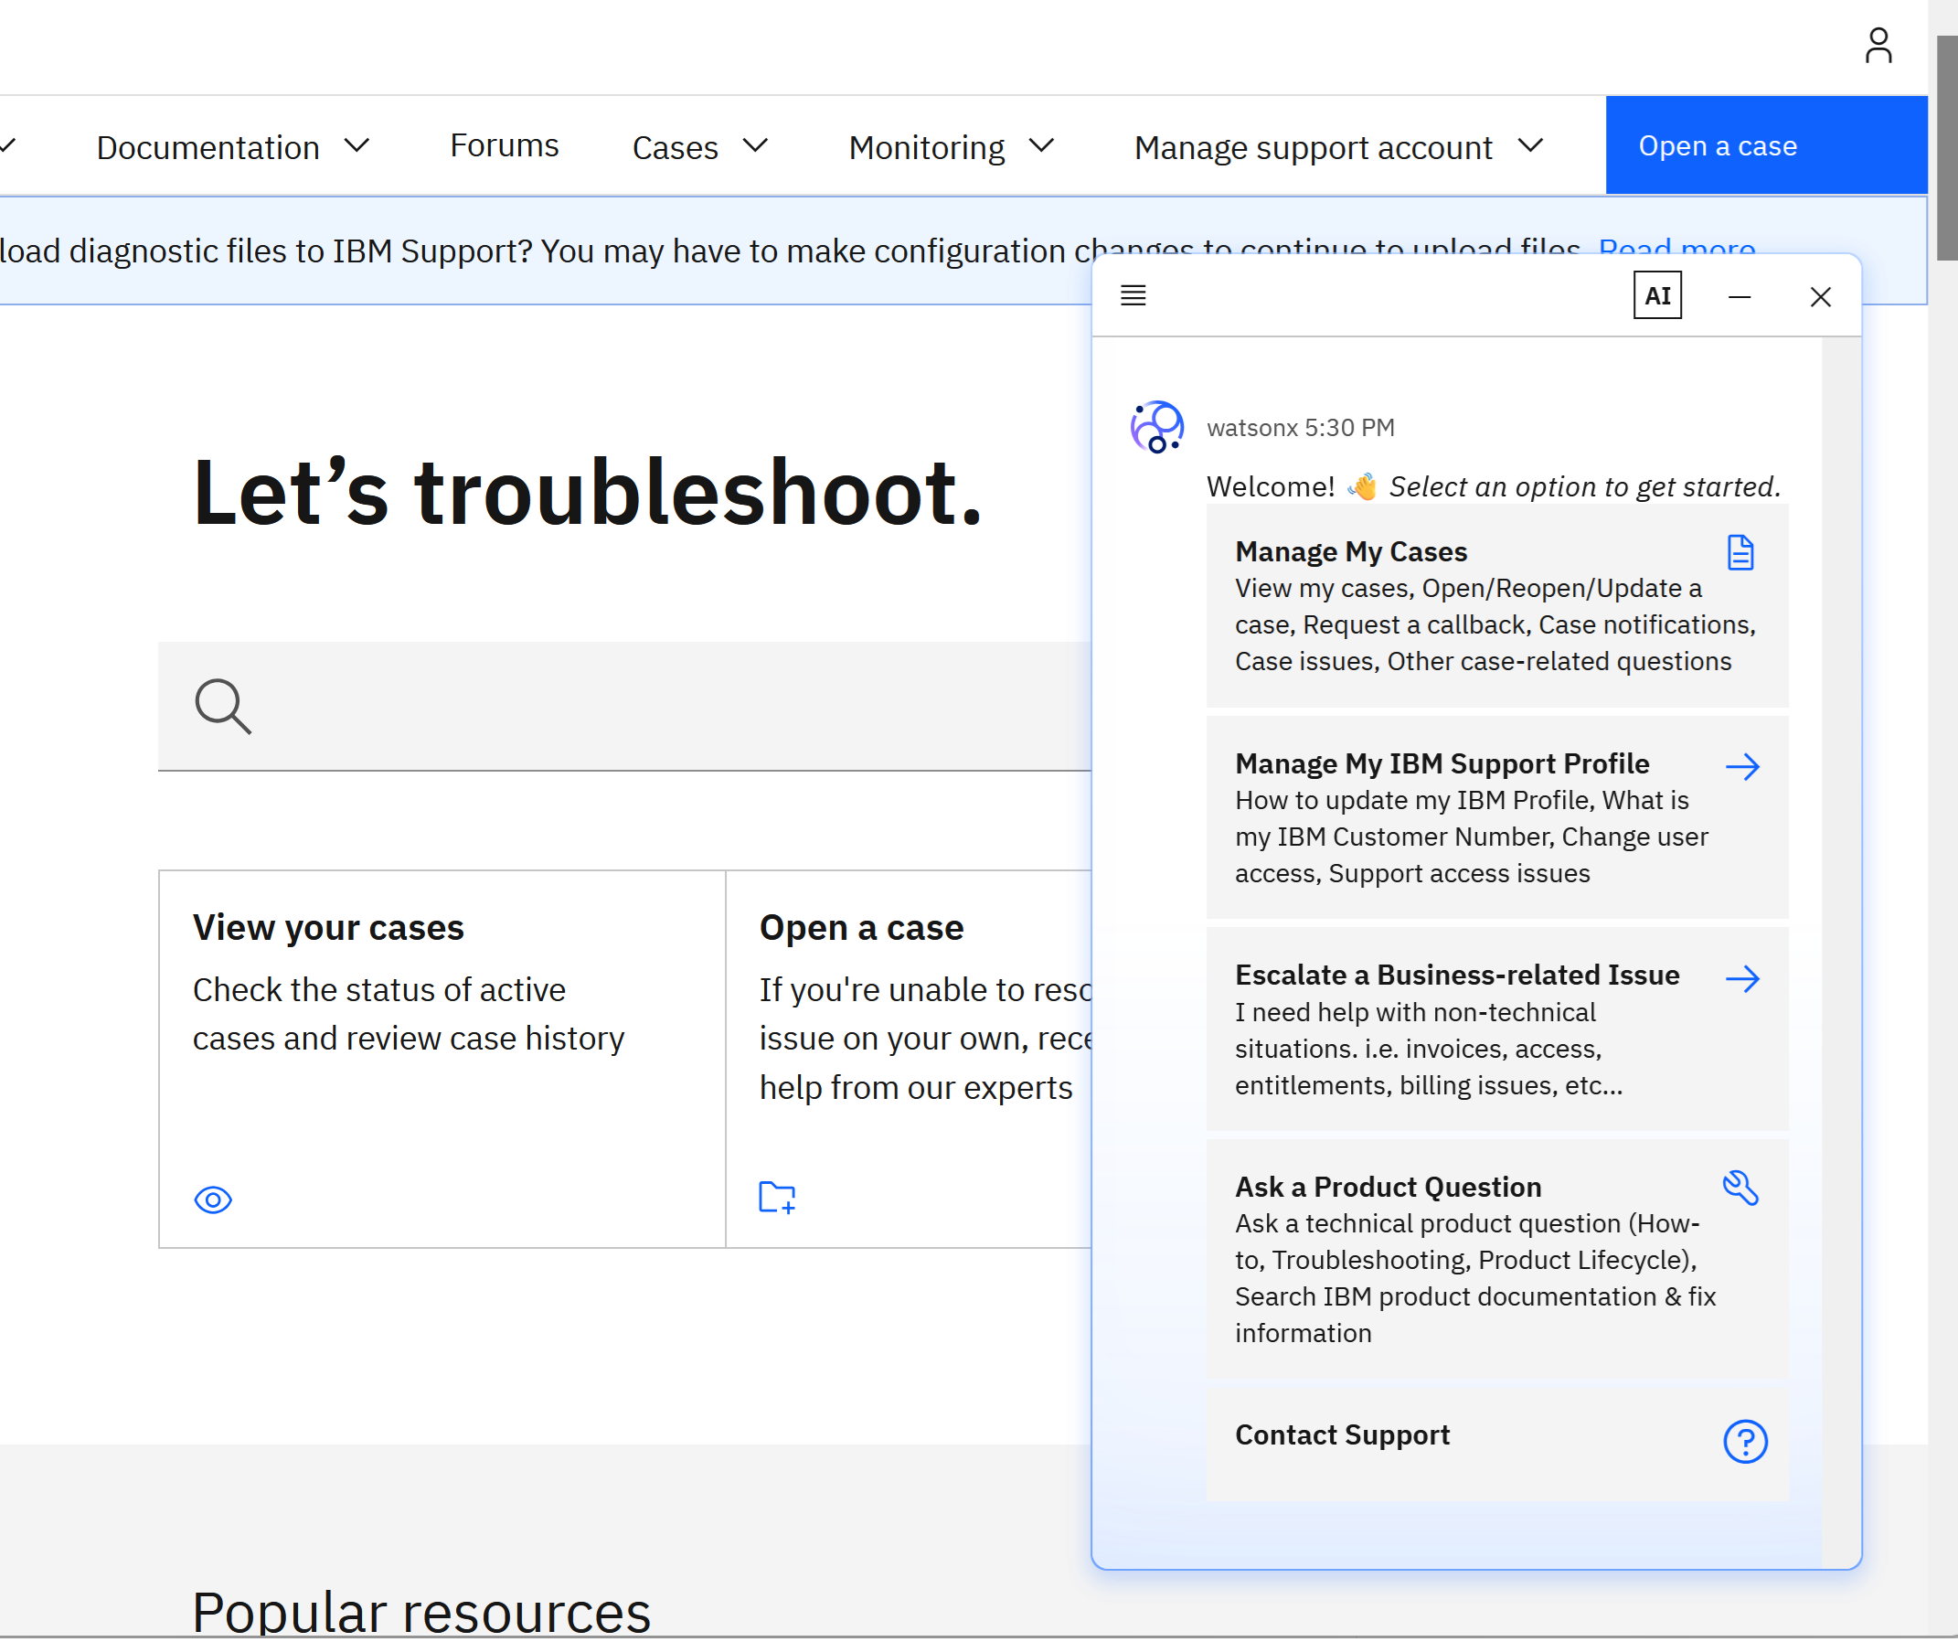
Chat: providing context is difficult
Attempts to provide context:
Introductory message
“Tips”
Suggested topics

Slide 22

Voice interface: No context
“What can I do here?”
“What can I ask about?”
“What can you do?”
https://commons.wikimedia.org/wiki/File:Rub_al_Khali_002.JPG

Slide 23
3/5 How the traditional process fails RAG, AI agents
Real user questions contain “incorrect” terms
Real user questions are based on “misunderstanding”
Real users ask about “unsupported” tasks
New AI interfaces lack context

Slide 24
4/5 Solution: question-driven content design
Collect real user questions
Test that content can answer those questions

Slide 25
4/5 Solution: question-driven content design
Collect real user questions
Test that content can answer those questions

Slide 26
QDCD step 1: Collect real user questions
You cannot guess
Your guesses will be biased due to familiarity with the source material
Your terminology, phrasing will be influenced by having worked with the content
Where to find user questions
Forums
User communities
User feedback
User research
Internet searchers
…

Slide 27
4/5 Solution: question-driven content design
Collect real user questions
Test that content can answer those questions

Slide 28
QDCD step 2: Test content
Forward
Configure the RAG/agentic solution to use the content as a knowledge base, submit real user questions, then evaluate generated answers.
Advantages
Results exactly match run-time results
Challenges
Setting this up is not trivial
Solutions are not all built the same (Do you test them all?)
Manual evaluation is time-consuming, automated evaluation can be misleading

Slide 29
QDCD step 2: Test content
Backward
Generate questions answered by the content, then compare the generated questions to the real user questions.
Advantages
Can be automated
Scales easily
Challenges
Is an indirect measure

Slide 30
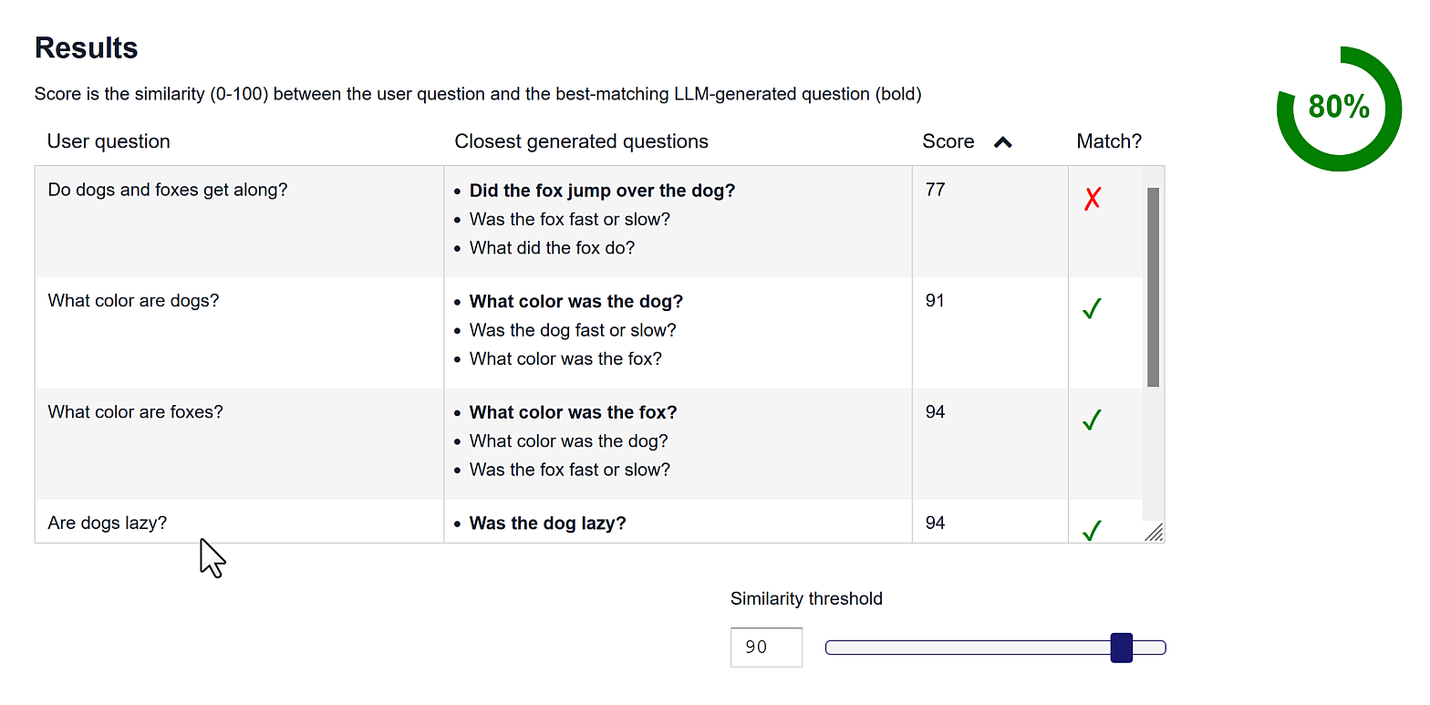
QDCD step 2: Test content (option 2)
https://youtu.be/OWoHlQt0ANo

Slide 31
5/5 Hands-on demonstration
bit.ly/Q-D-C-D

Slide 32
Lesson
Be less attached to our traditional processes and guidelines. Create content to meet readers where they are.

Slide 33
Lesson
Be less attached to our traditional processes and guidelines. Create content to meet readers where they are.
Thing 2 to remember

Slide 34
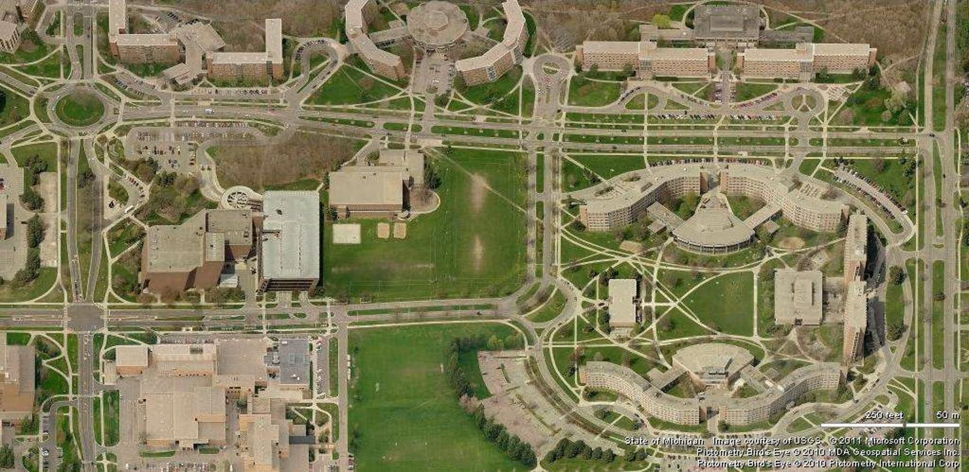
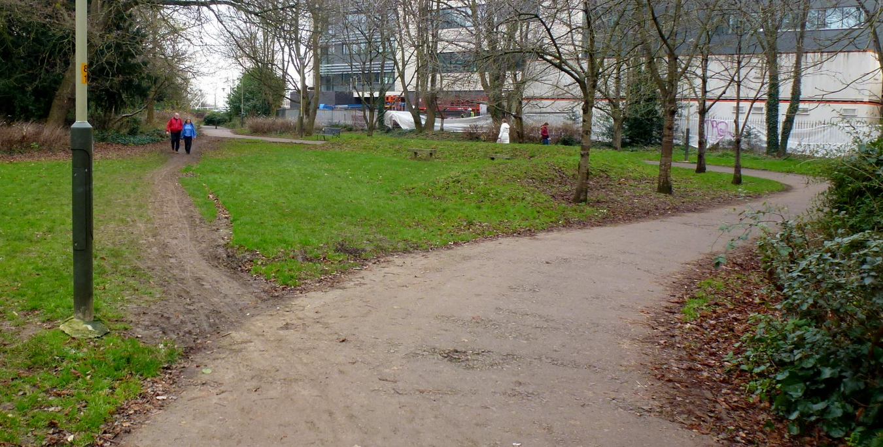
Lesson
Desire path (desire line)
https://en.wikipedia.org/wiki/Desire_path
https://www.theguardian.com/cities/2018/oct/05/desire-paths-the-illicit-trails-that-defy-the-urban-planners
https://commons.wikimedia.org/wiki/File:Desire_line_-_geograph.org.uk_-_6020249.jpg

Slide 35
Question-driven content design
Fact : Rag, agentic solutions depend on content

Slide 36
Question-driven content design
Fact : Rag, agentic solutions depend on content
#1

Slide 37
Question-driven content design
Fact : Rag, agentic solutions depend on content
Problem : Current content design process fails RAG, agentic solutions
#1

Slide 38
Question-driven content design
Fact : Rag, agentic solutions depend on content
Problem : Current content design process fails RAG, agentic solutions
One solution : Question-driven content design
Collect real user questions
Test that content can answer those questions
#1

Slide 39
Question-driven content design
Fact : Rag, agentic solutions depend on content
Problem : Current content design process fails RAG, agentic solutions
One solution : Question-driven content design
Collect real user questions
Test that content can answer those questions
New reality : We need to write for users where they are
#1

Slide 40
Question-driven content design
Fact : Rag, agentic solutions depend on content
Problem : Current content design process fails RAG, agentic solutions
One solution : Question-driven content design
Collect real user questions
Test that content can answer those questions
New reality : We need to write for users where they are
#1
#2

Slide 41
Resources
bit.ly/Q-D-C-D

